Slide 1
So you want to be a mentor
Taking someone from noob to knowledgeable

Slide 2
Overview
If you work in infosec, you’ve probably been asked how to break into the field
Usually, those wanting in don’t have the money for college classes, SANS and online courses, nor is that the most effective way to learn
Good news: there’s tons of information and software online for free!
Bad news: There’s a lot of stuff to learn – operating systems, networking, applications, scripting, compliance/audit, operations, process/methodology….

Slide 3

What’s in this talk?
This is intended to be a roadmap for motivated and self starting individuals
There is no original content here; I’m really good at plagiarizing

Slide 4

Who you should take on and What to look for
Attitude - looking to commit to life long learning and helping other people in the process
Aptitude - Not everyone can be an astronaut….
Work ethic - self starter, willing to google for the answer

Slide 5

Roadmap Outline
Security Basics and Methodology
Networking basics
Operating system basics
Cryptography
Infosec components
Home lab requirements
Useful Tools and continued learning

Slide 6
Security Basics and Methodology
Confidentiality, Integrity and Availability
Least Privilege
Reducing the attack surface
Risk Management
Authentication, Authorization and Accountability
Passwords and multi-factor authentication

Slide 7
Networking basics
7 layer OSI model, Please Do Not Throw Sausage Pizza Away
LAN/WAN basics
Protocols and encapsulation
MAC and switching
IP and routing: addressing, subnets, masking, DG, ARP, NAT
TCP/UDP/ICMP and upper layers: common services like HTTP, DNS, SSH, FTP, SMB, DHCP, SSL, services and ports….
Ethernet, Wifi, Cellular
Routers, switches, firewalls, WAP, WAF, Identity Management

Slide 8



Operating System basics
Windows: permissions, networking, services
Advanced topic: useful Windows tools and utilities
Active directory services
*nix - includes MacOS, BSD, Linux, UNIX
File system basics: changing and creating directories, permissions, man pages, networking, services, useful commands, shell basics
VI
Basic commands everyone should know
Compiling from source
Finding and Filtering Logs

Slide 9

Cryptography
SSL vs IPSec
VPNs
Certificates and how they are used
Symmetric and Asymmetric
PKI
Algorithms and hashes

Slide 10
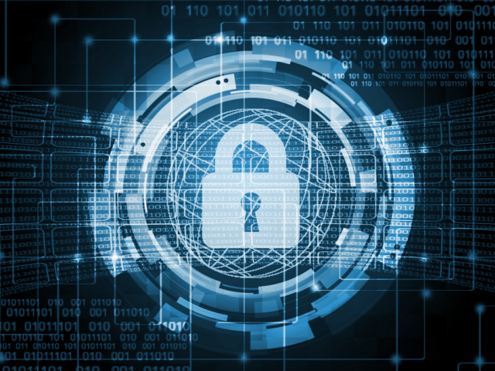
Infosec Components
Endpoint security: AV and anti-malware, host firewall, OS hardening
Network security basics: groups, access, policy, segmentation
IDS/IPS, File inspection (AM), Content Filtering, DLP
Hardening, Patching and vulnerability scanning
SIEM and orchestration: need to understand the outcome
Cloud: load balancing, Saas vs PaaS or IaaS, pets vs livestock
Notes:
CIS hardening standards

Slide 11
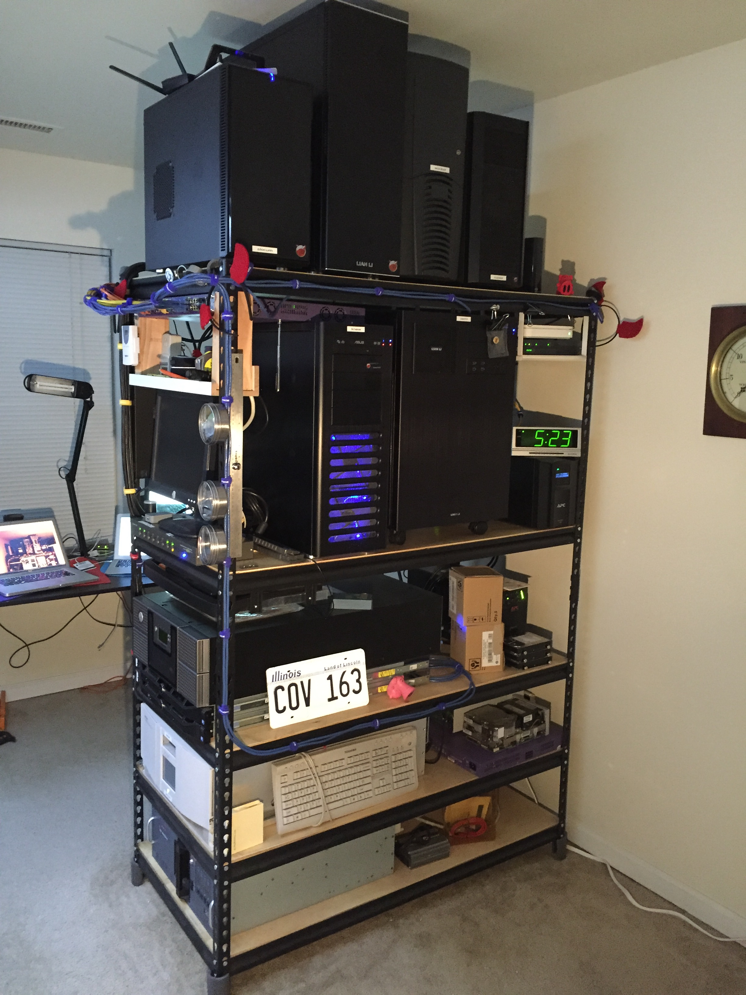
Home lab requirements
PC - 16 G RAM, 500GB disk, multi-core processor
High speed Internet
One or more switches
Raspberry Pi
One or more Wifi routers
Cloud free tier, e.g. AWS

Slide 12

Useful tools and continued Learning
Virtualbox
Wireshark
Snort
Nessus
Python
Kali Linux
Regional cons, local defcon group, BSIDES, local 2600 group….

Slide 13
Questions
nmoore9041@gmail.com
Twitter @sec_nmoore

